Slide 1
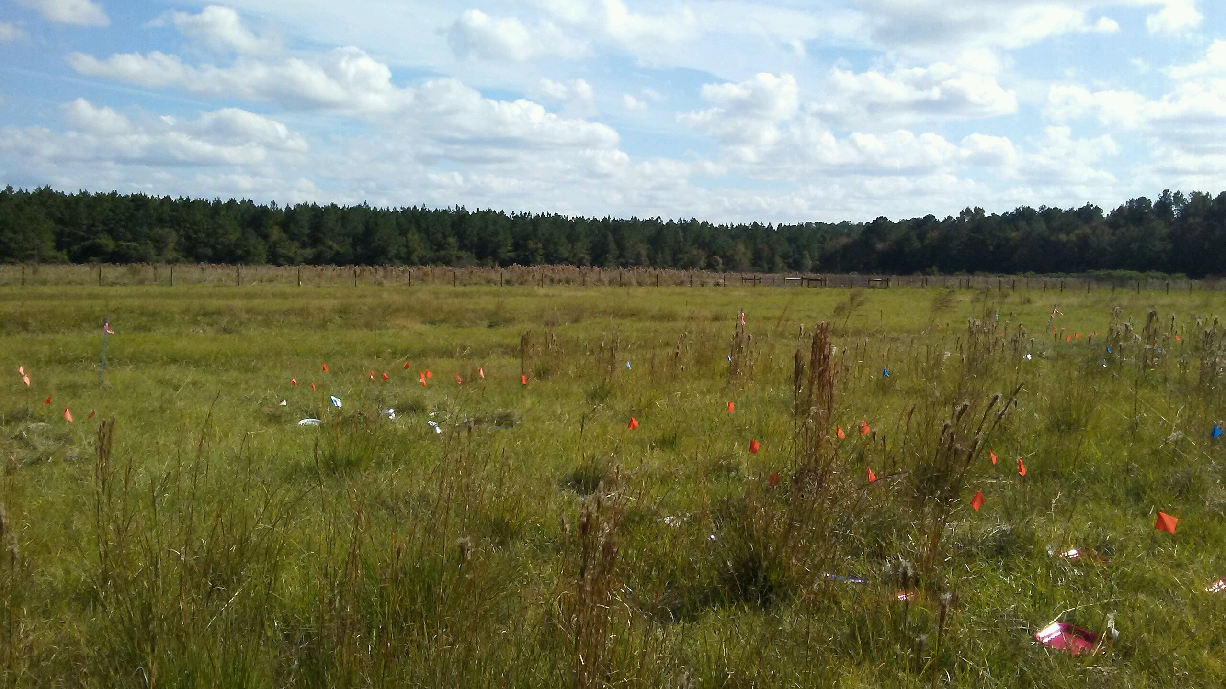
Estimate trends in root-rhizome production within a perennial grassland in relation to:
Seasonality
Spatial variation
Additional effects of:
Vegetation composition
Simulated grazing
Beef Unit, Gainesville FL

Slide 2
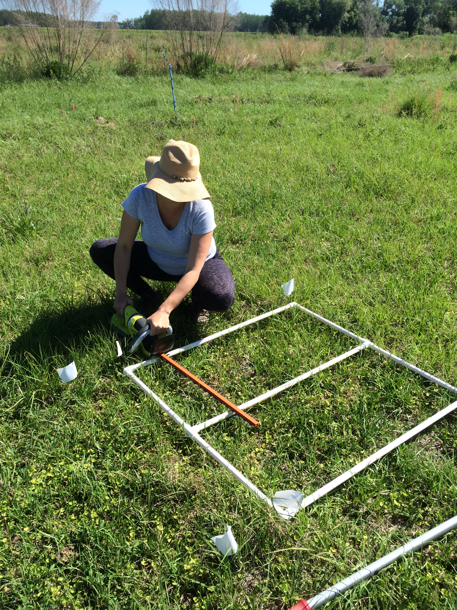
Experimental Design
*
1
*
13
2
14
3
15
2 pasture vegetation compositions
4 blocks Bahia
4 blocks Mixed (bahia + Rhizoma peanut)
24 plots
16 3-m x1-m
8 1-m2
Each plot: 2 treatments + control (UC) randomly assigned
Clipping (~1.5”) monthly (C)
Clipping + manure application (CM)
*
4
16
17
5
*
6
18
*
7
19
20
*
8
9
21
*
C
10
CM
UC
*
22
23
24
11
12

Slide 3
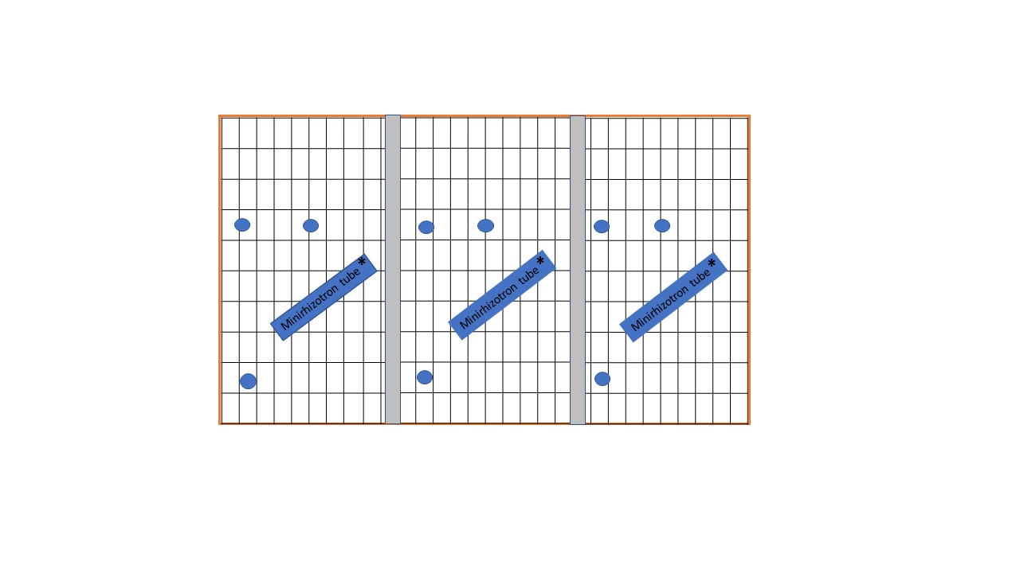
MiniRhizo Tron
13
1
2
14
3
15
24 minirhizotron tubes installed in 8 plots (May 2019)
Tubes are 2” diameter, 0.9-m length
Installed at a 45º to a depth of ~50-cm
4
16
17
5
6
18
7
19
20
8
9
21
10
22
23
24
C
CM
UC
11
12
Notes:
Tubes were installed so approx 15-cm remained aboveground. So total length BG = 76.44-cm

Slide 4
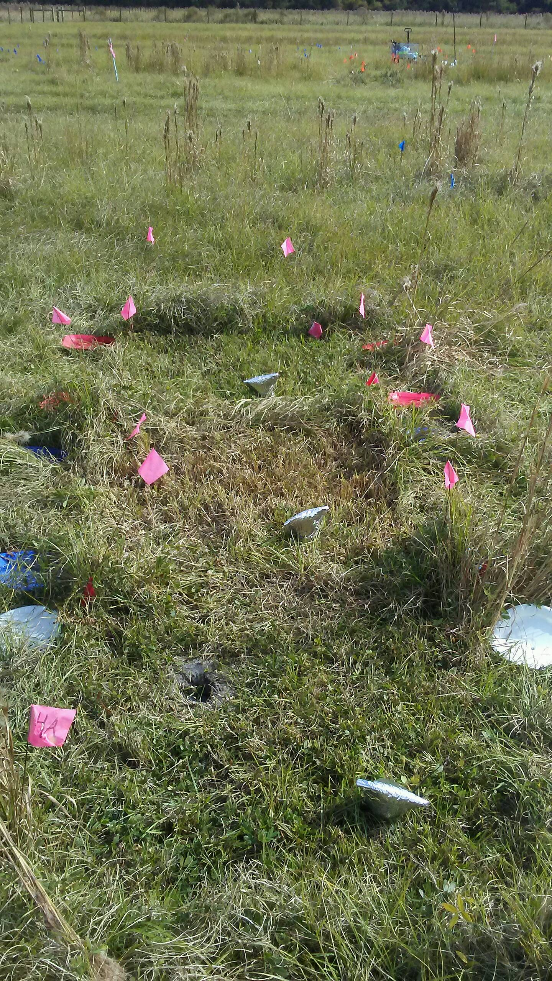
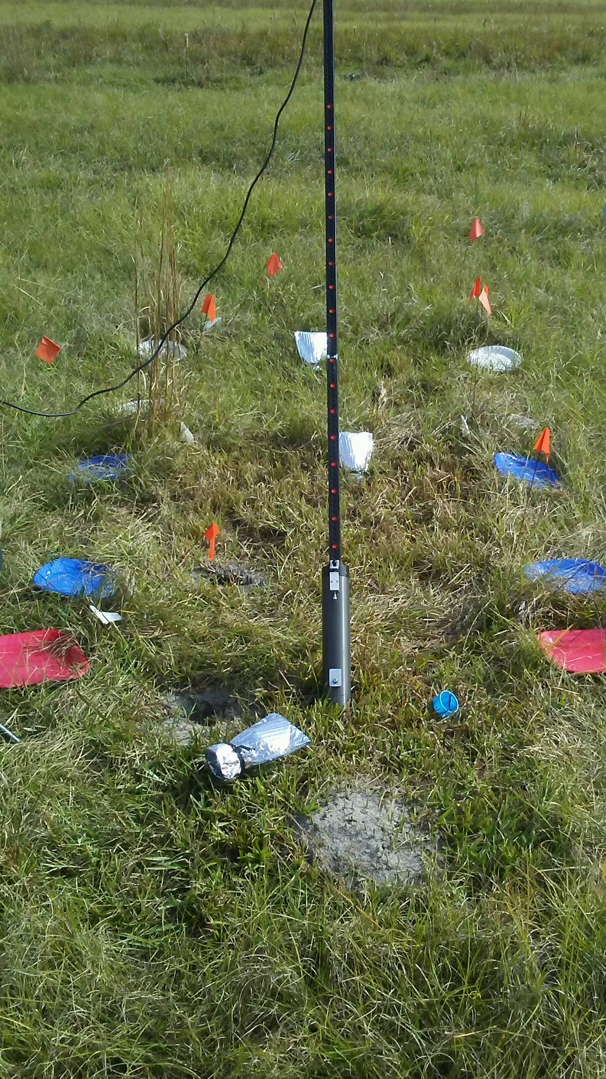
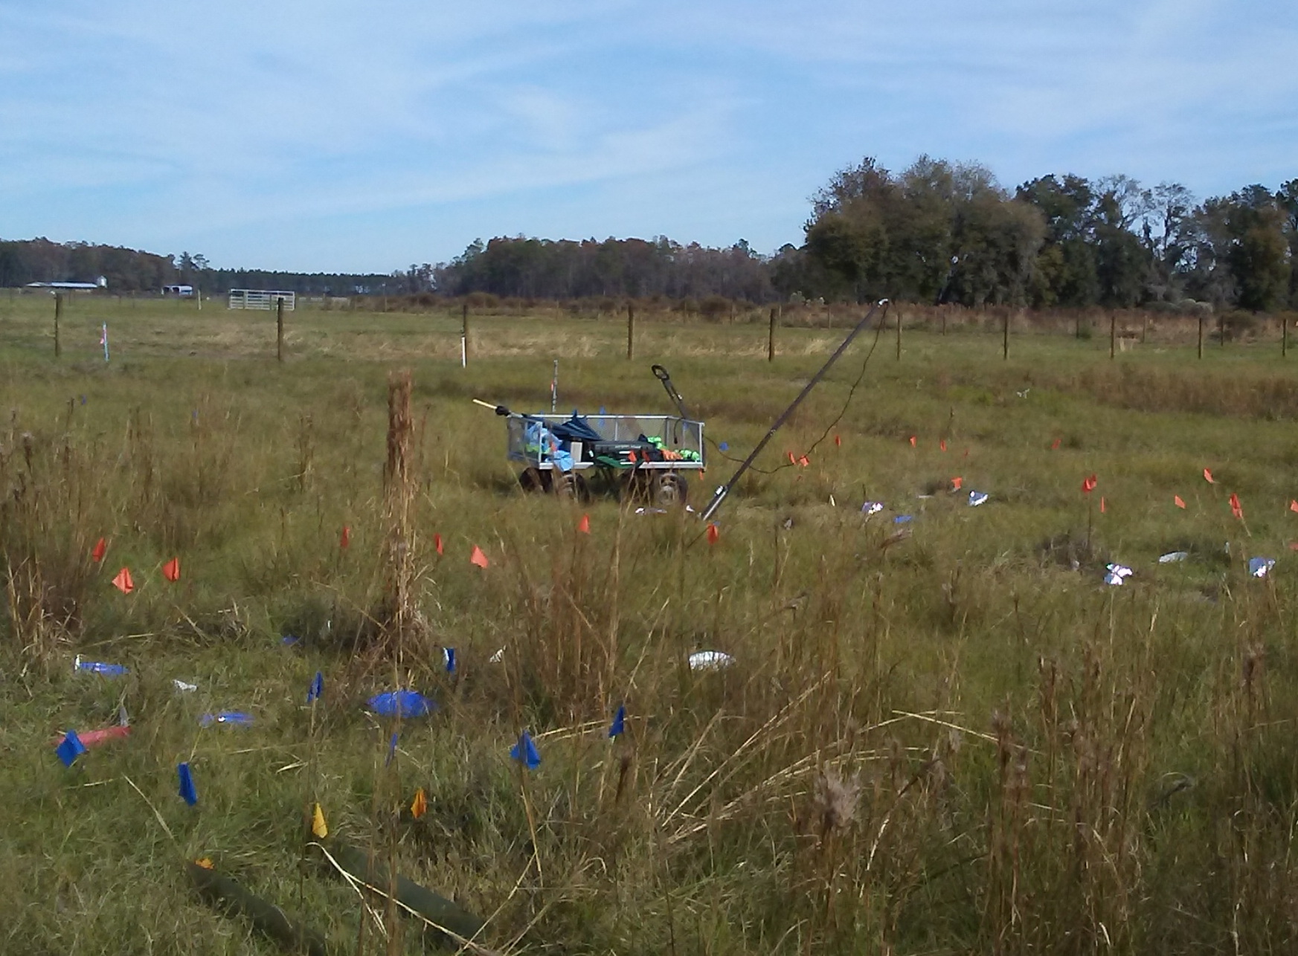

Slide 5
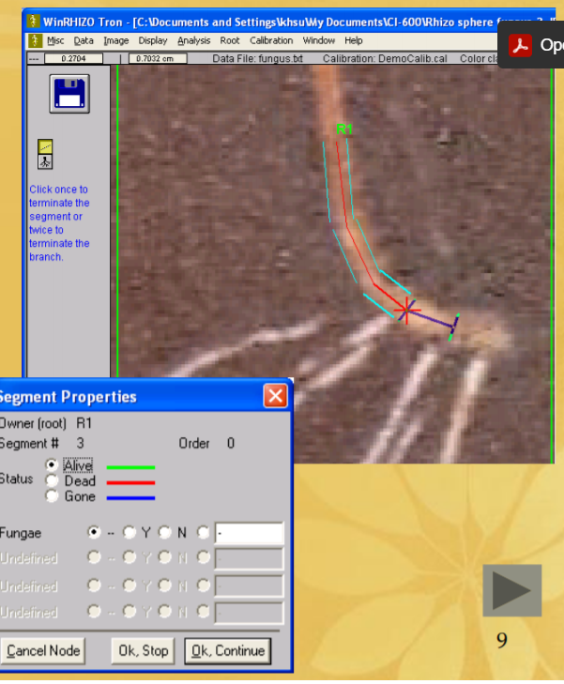
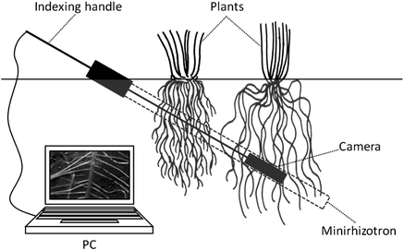
24 tubes
44 “locations” for each tube
Recorded each month April-November
~1056 photos/month
~8448 photos for 2020

Slide 6
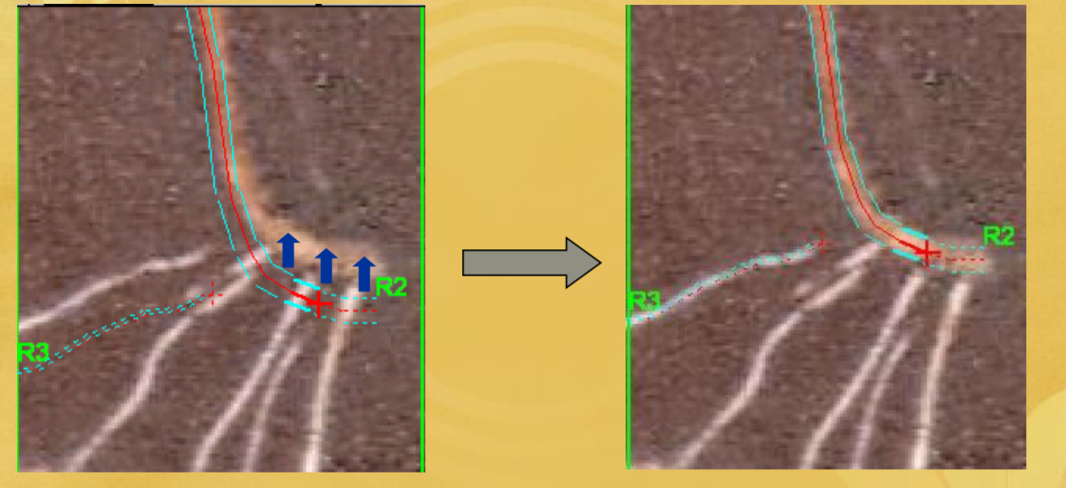
WinRhizoTron-Root Template

Slide 7
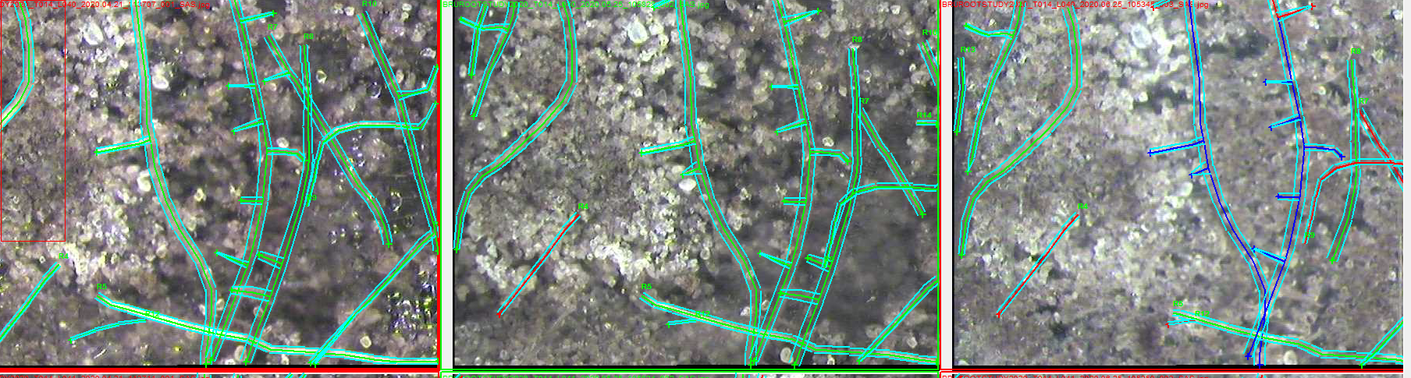
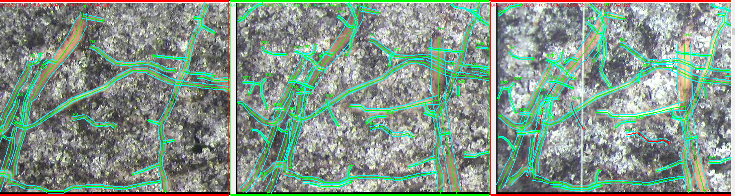
APRIL
MAY
JUNE
Notes:
Top is tube 12, a bahia cut treatment
Bottom is tube 14, mixed combo treatment

Slide 8
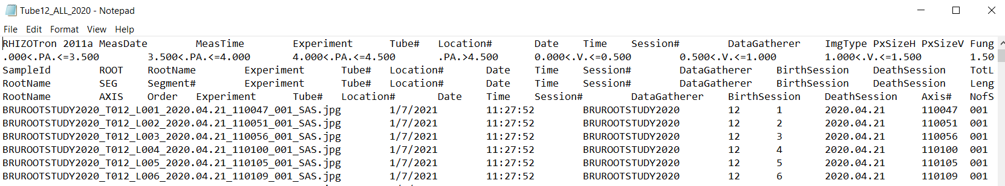
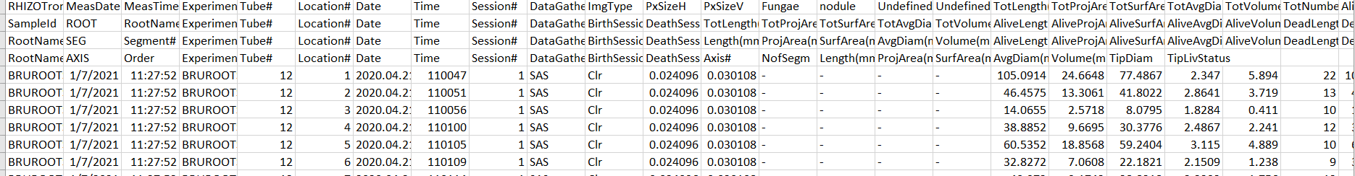
WinRhizo Tron Data

Slide 9
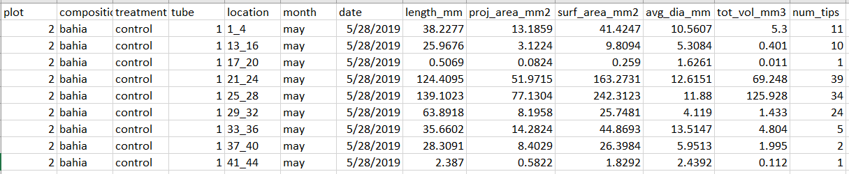
WinRhizo Tron Data
For each location within a tube records for “total”, “alive”, “dead”, and “gone”:
length (mm)
Average diameter (mm/10)
# tips
Classes for length (ex: 0-<0.5, 0.5-<1.0, 1.0-<1.5…) and tips

Slide 10
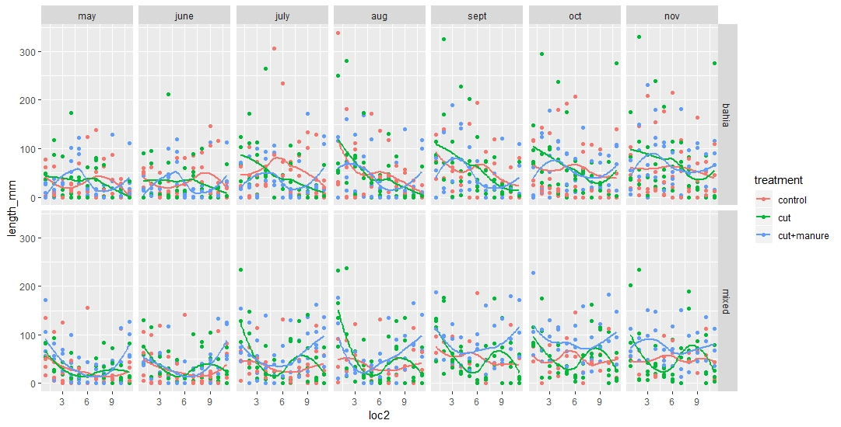
Total Root Length 2019
Notes:
No pattern with depth-less turnover at deeper depths?

Slide 11
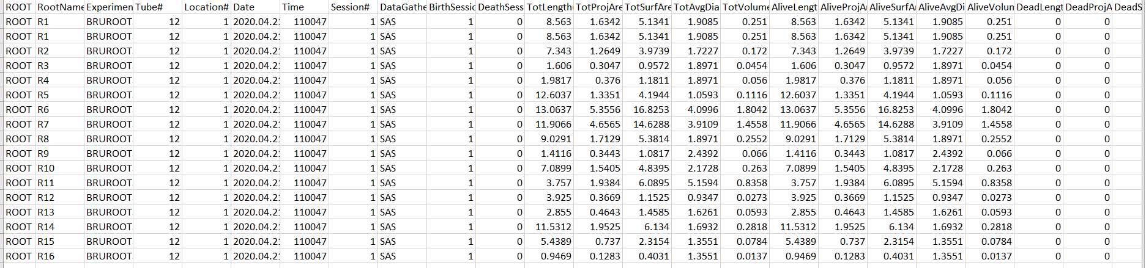
WinRhizo Tron Data (Roots)
For each named root
Birth session
Death session
Length (mm)
Average diameter (mm/10)
Volume (mm3)
Tip diameter

Slide 12
Decisions
Gone roots
Roots marked dead then found alive in successive months
Roots partially marked dead/gone

Slide 13
2020 Data collection (March– November)
Monthly
Above-ground biomass of clipped vegetation-Forage Production
Rhizotron images-root production/turnover
November only
Subsample (0.25-m2) of total AG biomass (ground to 7.5-cm) and surface litter -ANPP
Weekly
Soil temperature
Soil VWC
Hourly
Rainfall
Additional data by Hannah Rusch, Hunter Smith
Tiller counts
Percent cover estimates by vegetation class
LAI
TRIME
Drone Imagery

